Slide 1
Forces & Motion
Vocabulary

Slide 2
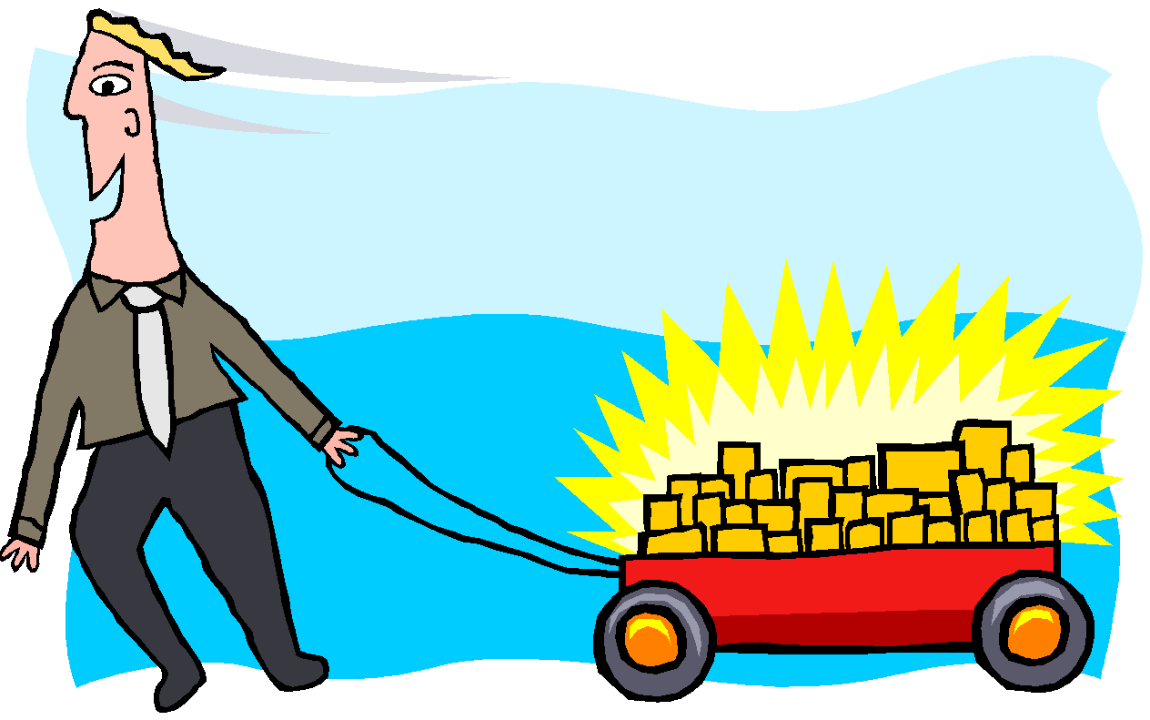
force
a push or a pull that acts on an object with or without direct contact

Slide 3
gravity
a force that acts between any two objects that pulls them toward one another

Slide 4
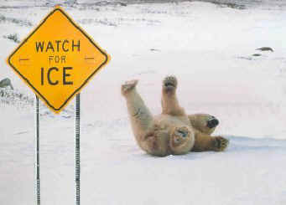
friction
a contact force that acts against movement when two objects touch each other; makes it harder for one surface to move past another

Slide 5
balanced forces
forces on an object that are equal in size and opposite in direction; they cancel each other out and there is no movement

Slide 6
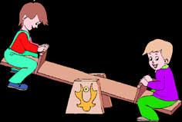
unbalanced forces
forces that are unequal in size and and may or may not be opposite in direction; causes movement (a change in motion); like friction, push, pull, gravity

Slide 7
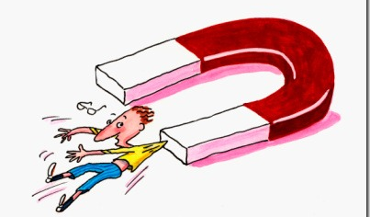
attraction
an electric or magnetic force that acts between oppositely charged objects, or to describe the gravitational force that draws objects toward each other

Slide 8
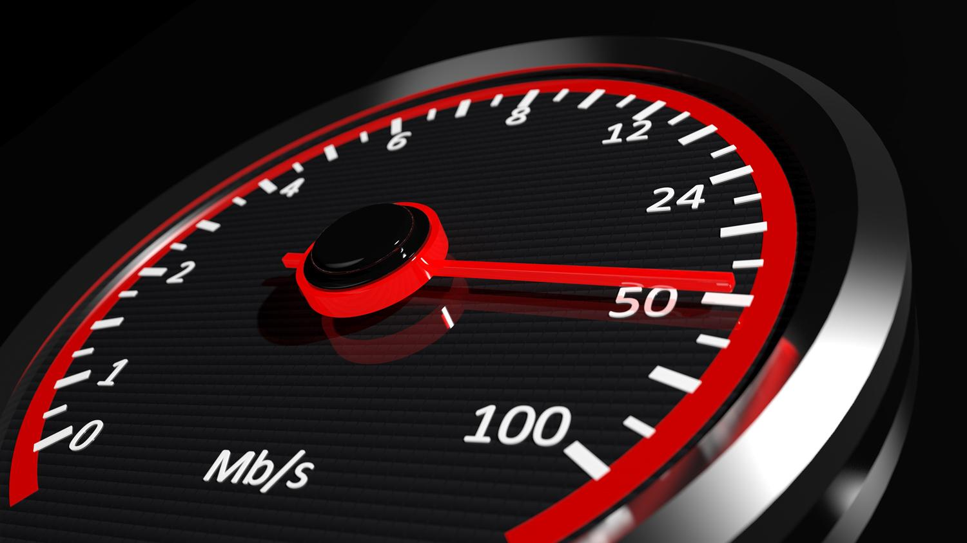
speed
the distance an object travels in a particular amount of time, such as a minute or an hour

Slide 9
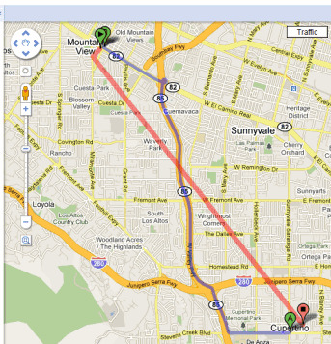
distance
the measurement of how far apart objects are

Slide 10
time
the duration in which all things happen; is what a clock reads

Slide 11
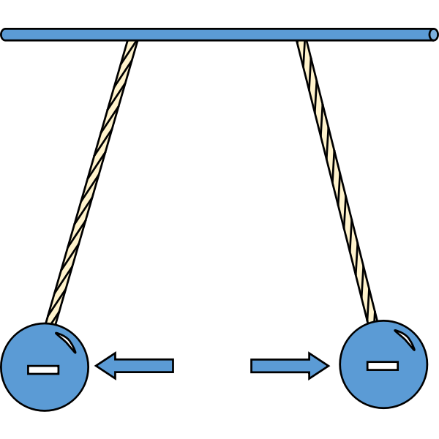
repel
to force something to move away; to push back or away by a force

